Slide 1
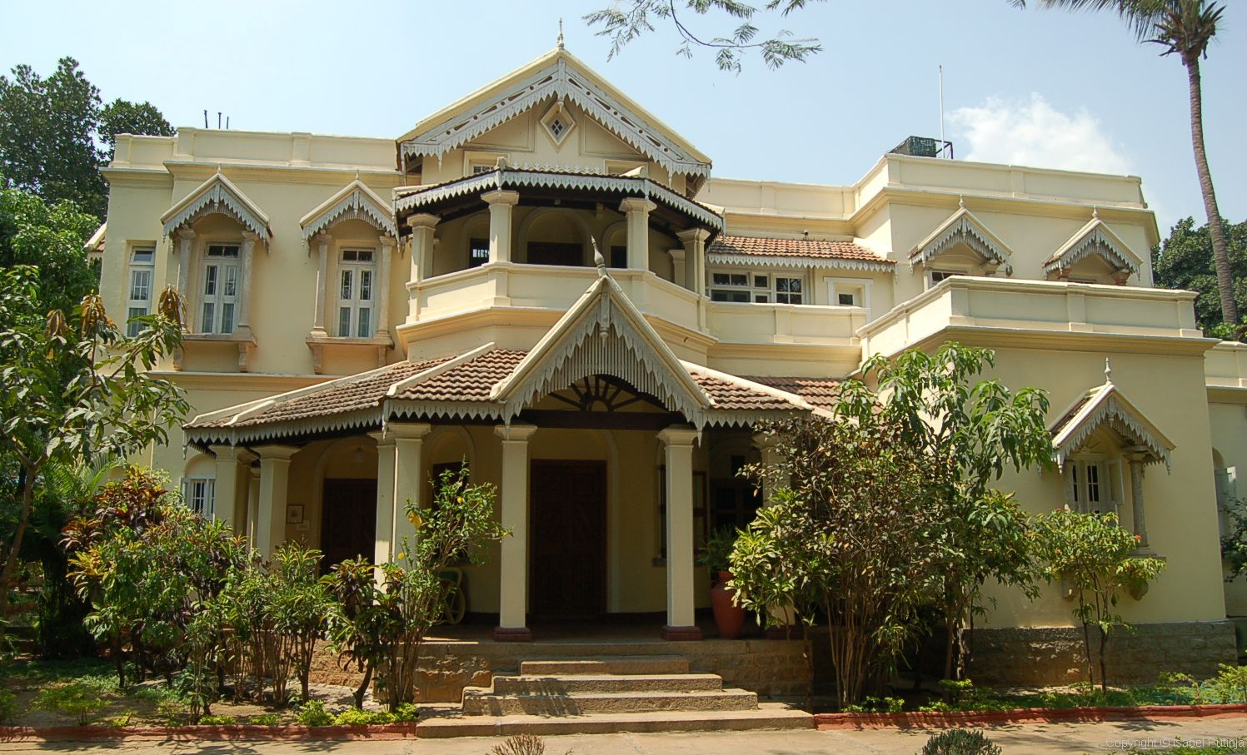
Bengaluru House Price Prediction
By Kritika Banerjee

Slide 2
Objective-
To predict the price of a house in Bengaluru based on size, total_sqft, number of rooms, and number of balconies, area-type and availability
Benefits-
This project will be able to predict correct price with almost 80% accuracy based on various factors like size, number of rooms, number of balconies, area-type and availability

Slide 3
Architecture
Start
Data collection
Data pre-processing
Feature selection
One hot encoding
Check accuracy score
Hyper parameter tuning
Model Training
Model creation
standardisation
Model dump in pkl file
Creating front end
Creating of flask app
Integration with front
Test check
End

Slide 4
Data Pre-processing-
We replaced null values or values with records less than 10 in location column by mostly occurred location name.
Similarly null values in size column is replaced by ‘2BHK’ which is mostly occurred in this case.
Number of bathrooms is replaced by median of the whole column.
Then we split the room column to extract numeric value from alphanumeric columns like ‘2 BHK’
The column total-sqft has range in between in some records, we wrote a specific function to convert the range value to average of that range
-for more info…List location or contact for specification (or other related documents)

Slide 5
Outlier detection
We made a new column- price per sqft in order to do outlier detection.
We analysed the size column using total_sqft/bhk which gives size now we check if the size of the house is less than at least 300 sqft, we drop that record.
For bhk we checked the price per sqft for any bhk should be more than at least mean of the previous BHK,
Meaning the price of 3BHK should be more than mean price of all 2 BHK or else it is an outlier.

Slide 6
Model Training-
Since Location was a categorical column I have used OneHotEncoding to encode categorical data into numerical columns.
Since the data was having high variance, I have used standard scalar to standardize the data.
We did a train and test split and used Linear Regression to train our model
We have used various regularisation techniques as well such as Ridge and Lasso in order to check which model was giving more accuracy,

Slide 7
One Hot Encoding
One hot encoding is a process of converting categorical data variables so they can be provided to machine learning algorithms to improve predictions. One hot encoding is a crucial part of feature engineering for machine learning.
Manually converting our data to numerical values includes two basic steps:
Integer encoding
One hot encoding

Slide 8

Standardisation
Standardization is the concept and step of putting different variables on the same scale. This concept allows comparing scores between different types of variables.

Slide 9
Prediction
the model predicts the price of the house based on input inserted by the user.
-for more info…List location or contact for specification (or other related documents)

Slide 10
Q/A
Q1.Tell me about your current project?
This project helps to predict the price of a house in Bengaluru based on size, total_sqft, and number of rooms, number of balconies, area-type and availability
We have used a lot of techniques for EDA in order to cleanse the data for optimum accuracy,
Handling null values, outlier detection and feature selection are to name a few.
Ridge Linear Regression is used to predict the price from the model.
Q2. What is the source of data?
Ans. Data was collected by internet .
Q3. how were you doing deployment?
Ans. The deployment was done on Heruko .
Q4. . how do you optimize your solution?
->we implemented three models check the accuracy of the best to select best model as per your cluster

